Slide 1
CSC358 Programming Assignment II: NAT

Slide 2
Recall PA I
Static topology + static routing table
IP Routing + ICMP messages
ARP requests and replies

Slide 3
PA II Overview
You’re going to write a “simplified” NAT (+Router)
Take your PA I
NAT handling ICMP and TCP

Slide 4
Recap: What is NAT?
NAT = Network Address Translation
Translate between IP address ranges
Private to public IP address
Private: 10.0.0.0/8, 172.16.0.0/12, 192.168.0.0/16
Enables one IP address to be shared among lots of devices
Conserve IPv4 addresses

Slide 5
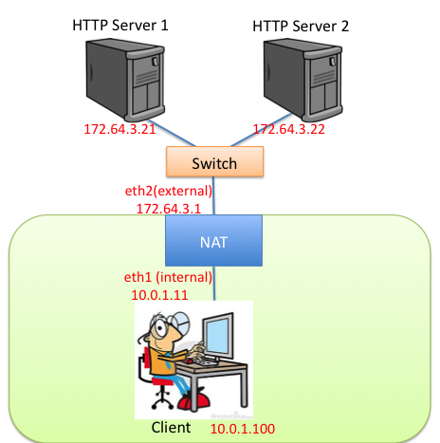
Outline
Use mininet to create a NAT
HTTP servers and switch are outside of NAT
Client is inside NAT

Slide 6
Required Functionality
Pinging the NAT's internal interface from client host machines
Pinging any of the HTTP servers
Downloading files using HTTP from the app servers

Slide 7
Required Functionality
Keep your PA 1 functionality
Enable NAT with ./sr_nat –n
ICMP messages
Ping echo request + reply
External host independence
TCP packets
Endpoint-Independent mapping behavior
Endpoint-Independent filtering
Simultaneous open
Mapping timeouts MUST be configurable
Refer to course webpage for detailed instructions

Slide 8
Example: ICMP Echo Request
Ping (ICMP ECHO)
Src: 172.64.3.1
Dst: 172.64.3.21
Id: 100
Ping (ICMP ECHO)
Src: client
Dst: 172.64.3.21
Id: 10

Slide 9
Example: ICMP Echo Reply
Ping (ICMP ECHO Reply)
Src: 172.64.3.21
Dst: 172.64.3.1
Id: 100
Ping (ICMP ECHO Reply)
Src: 172.64.3.21
Dst: client
Id: 10

Slide 10
ICMP: External Host Independence
Rewriting is the same,
Independent of packet destination
Timeout after 60 seconds
Ping (ICMP ECHO)
Src: client
Dst: 172.64.3.21
Id: 10
Ping (ICMP ECHO)
Src: client
Dst: 172.64.3.22
Id: 10
Ping (ICMP ECHO)
Src: 172.64.3.1
Dst: 172.64.3.21
Id: 100
Ping (ICMP ECHO)
Src: 172.64.3.1
Dst: 172.64.3.22
Id: 100

Slide 11
TCP: Requirements
Endpoint-Independent Mapping behavior
If a mapping (x,px)→(x’,px’) is created for a packet destined to (y1,py1)
Then the same mapping is used for for packets from (x,px) to (y2,py2) (i.e. doesn’t depend on endpoints)
Endpoint-Independent Filtering
If a mapping (x,px)→(x’,px’) is created for (y1,py1), then allow (y2,py2) to communicate to (x,px) via (x’,px’)
Simultaneous open
Dealing with Inbound SYNs
Timeouts and a few others (webpage lists all)
Use ports > 1023 for mapping.

Slide 12
Threads!
Spawn a thread to timeout NAT entries
Similar to ARP cache timeouts
Search code for pthread_create, pthread_mutex_lock
Synchronize access to shared data using locks
NAT mapping lookup, insertion, deletion, etc.
Be conservative with locks☺
Race conditions harder to debug than deadlocks

Slide 13
Data Structures
Mapping table
Linked list is fine, O(n) lookup
ICMP or TCP
Keep a time field to remember when a mapping was used
Remember: locks!
Protect all accesses: lookup, insertion, deletion

Slide 14
Rough pseudocode
Receive packet on an interface
Check if ICMP or TCP
If packet is outbound (internal -> external)
insert or lookup unique mapping
else:
if no mapping and not a SYN (for simultaneous open)
drop packet
Rewrite IP src (dst) for outgoing (incoming) packets
Rewrite ICMP ID / TCP port
Update relevant checksums
Route packet

Slide 15
Rough pseudocode
This is just to give you a rough idea
Details missing (rules for filtering, reusing mapping, etc.)
ICMP port unreachable, etc. Locks ☺
Read instructions for detailed information
Start early!
Due Friday Mar 30

Slide 16
Summary
Build on top of PA 1
NAT must work for ICMP, TCP
UDP: not required, but up to you...
Clear defunct mappings using timeouts
Timeouts must be configurable
ICMP query id timeout
TCP established timeout
TCP transitory timeout (e.g. SYN sent but no response)
Which means you have to track TCP state transitions ☺

Slide 17
Things Might Be Helpful
Modularize your code!
To handle NAT state insertions, lookups, etc.
Dealing with ICMP, TCP
Start with ICMP first, then move to TCP
Debugging workflow
Mininet console, tcpdump, ping, wireshark
GDB/Valgrind
Debug Functions
print_hdrs, print_addr_ip_int

